Slide 1
Namespaces

Slide 2
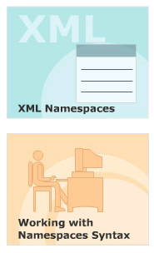
Module Introduction
Welcome to the module, Namespaces.
This module introduces XML Namespaces and the reasons for using Namespaces in XML documents.
This module aims at giving a clear understanding of Namespaces syntax.
In this module, you will learn about:
  XML Namespaces
  Working with Namespaces Syntax

Slide 3
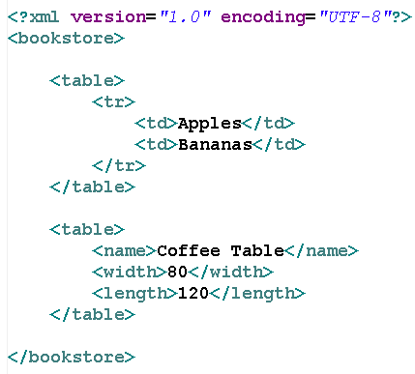
Need for a Namespace
In XML, element names are defined by the developer.
This often results in a conflict when trying to mix XML documents from different XML applications.
XML Namespaces Provide a method to avoid element name conflicts.

Slide 4
Define Namespaces
In XML, elements are distinguished by using namespaces.
  XML Namespaces provide a globally unique name for an element or attribute so that they do not conflict one another.
A namespace is a collection of names that can be used as element names or attribute names in XML document.
Namespaces allow the browser to:
  Combine documents from different sources, and help identify the source of elements or attributes.
A Namespace is identified by the URI.

Slide 5
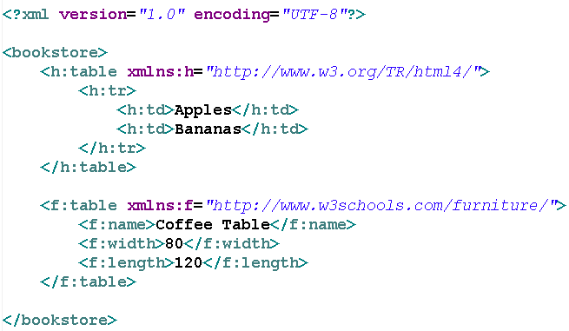
XML Namespaces Syntax- The “xmlns” Attribute
The namespace is defined by the “xmlns” attribute in the start tag of an element.
Syntax: xmlns:prefix="URI"
Prefix must not begin with “xml” or “xmlns”
The namespace URI is not used by the parser to look up information

Slide 6
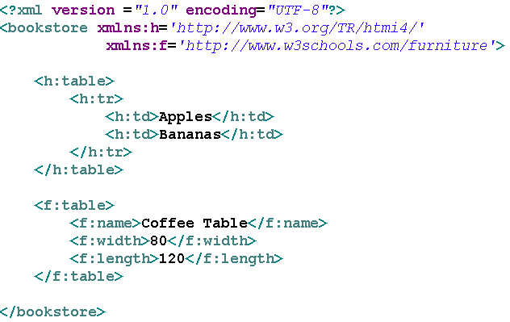
XML Namespaces - The “xmlns” Attribute
Namespaces can be declared:
  In the elements where they are used
  In the XML root element

Slide 7
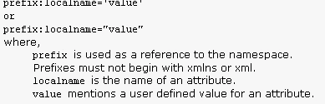
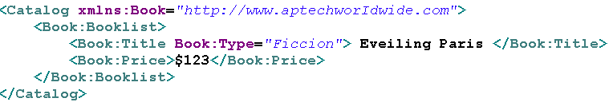
Placing attributes in a namespaces
Syntax
Example

Slide 8
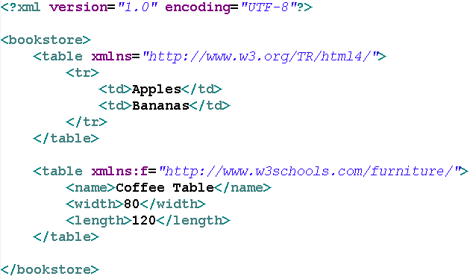
Default Namespaces
Defining a default namespace for an element saves us from using prefixes in all the child elements.
Syntax: xmlns="URI"

Slide 9
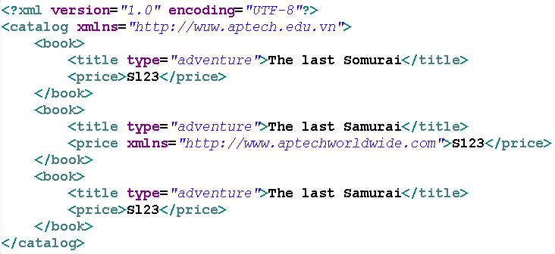
Override default namespaces
The default namespaces applies to the element on which it was defined and all descendant of that elements.
If one of the descendants has another default namespaces defines on it, this new namespace definition overrides the previous one and become the default for that element and all its descendents.

Slide 10
That’s all for today!
XML Namespaces
Working with Namespaces Syntax
Thank you all for your attention and patient !

